Slide 1
Automated Image Interpretation of Hazardous Material Transport Incidents
Xiongming Dai,
1/28/2018

Slide 2
1.Project Objectives
Develop a method of processing and analyzing images captured by the crowdsourcing and first-responders for assessing hazardous material transportation incident scene.
The outcome of the project will be a component of a smart safety enhancement system that improves the responsiveness and effectiveness of emergency responders and hospitals in dealing with hazardous material transportation incidents.

Slide 3

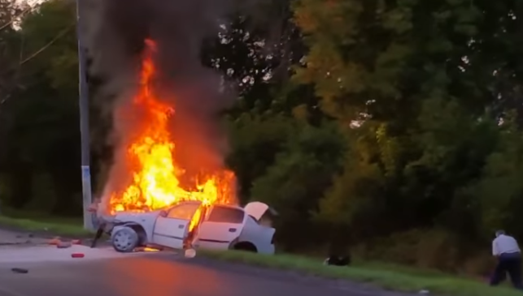
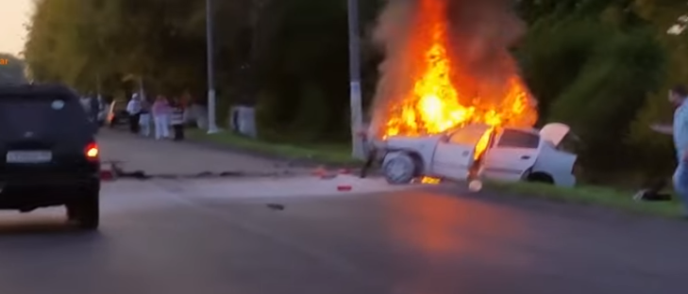
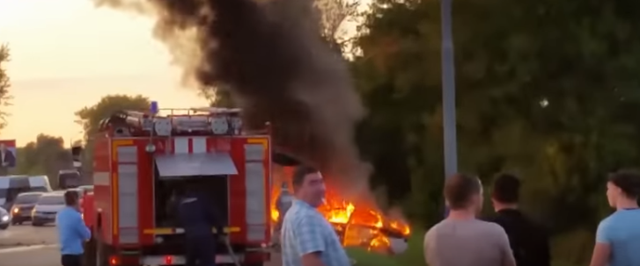
1.Project Objectives
Input: Frames from a video
Frame1
Time track
Frame N
• • • •
• • • •

Slide 4
1.Project Objectives
Output: Image Captioning
large green tree
big fire
electric wire
many green
leaves
green grass
a car
a white car
a man was sitting
A white car caught fire by the roadside, and many people were standing nearby.

Slide 5
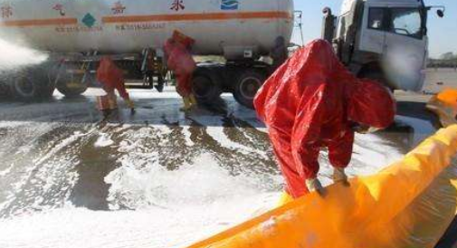
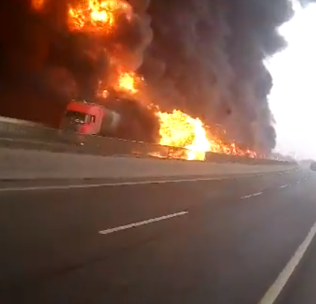
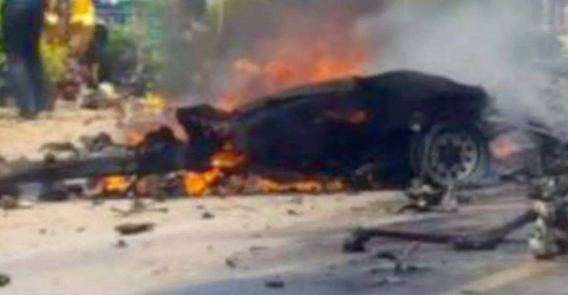
2.Background
When the hazmat incidents occur, effective emergency response is critical to minimize the impact of the incident.
A car with some toxic liquid pours.
The tanker caught fire.
A car with firework exploded.

Slide 6
2.Background and application
Traditional ways to identify the scene can be time consuming and affected by many subjective factors from first-responders.
Image captioning can objectively and fastly evaluate and respond to the incident.

Slide 7
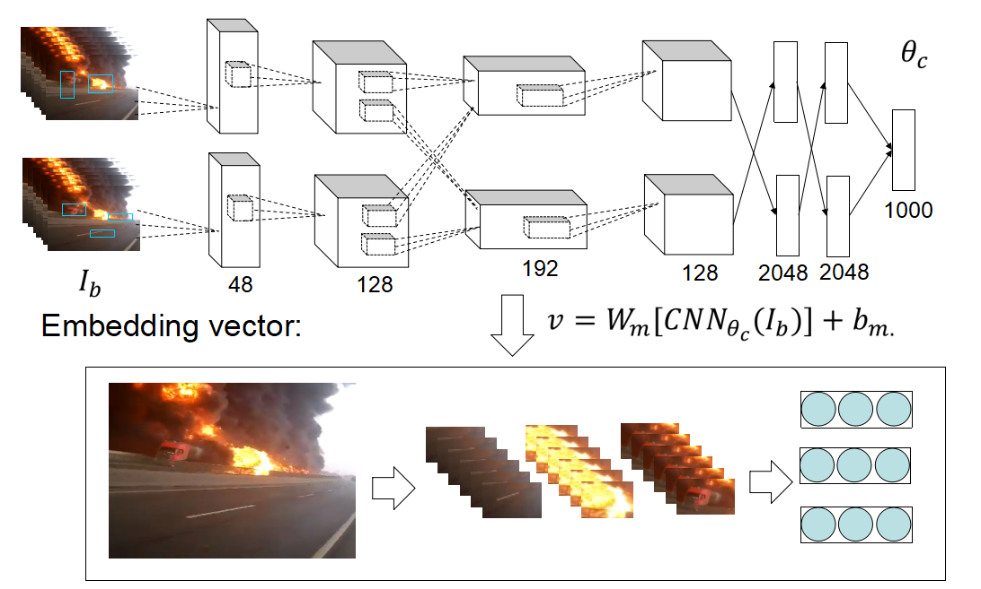
3.Methodology
Detection(by convolutional neural network)

Slide 8
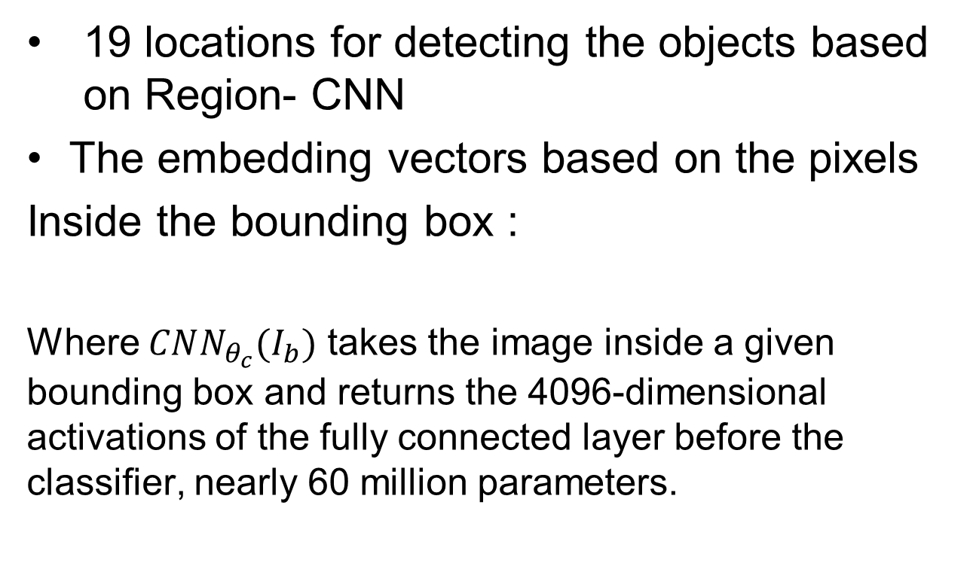


3.Implementation
Detection
(by convolutional neural network)

Slide 9
3.Purpose
Generate pixels vector representation
We can use neural network to train the parameters of weigths and biases for the superise learning. And then to extract some
abstract pixels vector representation for associate objects. That is useful for detection, classification and recognization.

